Slide 1

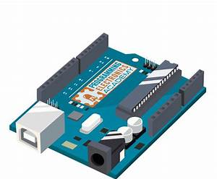
BANGABANDHU SHEIKH MUJIBUR RAHMAN DIGITAL UNIVERSITY, BANGLADESH
শিক্ষা নিয়ে গড়বো দেশ তথ্য-প্রযুক্তির বাংলাদেশ
PROJECT PRESENTATION
COURSE CODE-IRE 105
COURSE TITLE-ELECTRONICS DEVICES AND APPLICATIONS SESSIONAL
PROJECT TITLE-SMART CLAP SWITCH
PREPARED BY:
GROUP-05
MEHRIN FARZANA(ID-21010013)
MARIA JAHAN MIM(ID-21010022)
ISMOT ARA(ID-21010027)
SADIA ISLAM MOU(ID-21010028)
Date of submission: 31-03-2024
INSTRUCTED BY:
SADIA ENAM
LECTURER
DEPARTMENT OF IRE, BDU

Slide 2
Table of Contents
Title | Page
Objectives | 01
Difference/upgradation/Comparison with the recent works | 02
Methodology | 03
Flow chart and Circuit Diagram | 04 - 05
Simulation | 06
Progress Summary | 07 - 08
Gantt Chart | 09
Conclusion | 10

Slide 3
Objectives
1
Create a zero-touch device; a sound activated switch.
Design and construct a sound activated switch.
Implement it with Arduino UNO, output devices and sensors as input.
Program the Arduino UNO.
Integrate the materials to turn the output device ON and OFF with the sensor.
Ensure safety features to prevent collisions or damage during operation

Slide 4
Difference/Upgradation/Comparison with the recent works
2
Removes traditional switches and introduces a new way to turn devices ON or OFF.
Bring an alternative to the traditional switches when in darkness one finds it hard to find the switches.
Introduces zero touch switches.
Improved user interaction and control options, setting it apart from conventional designs.
Upgraded functionality and utility compared to standard switches,
offering advanced manipulation abilities.

Slide 5
Methodology
3
1. Simulation: Utilized Proteus software to simulate system components and verify functionality.
2. Arduino Code: Developed code to monitor sensor state, detect trigger,
and trigger actions.
3. Hardware Setup: Assembled components including sensors, Arduino, and output devices.
4. Integration: Integrated Arduino with hardware, ensuring seamless
communication.
5. Testing: Conducted thorough testing to validate system
performance and responsiveness.
6. Documentation: Documented progress, design specifications,
code, setup instructions, and testing procedures for reference and
future maintenance.

Slide 6
Flow chart
4
Sound
Mcrophone
Analog signal
OpAmp comparator
Digital signal
Arduino
Relay
LEDs
5 V
5 V
5 V
Figure 1: Flow chart

Slide 7
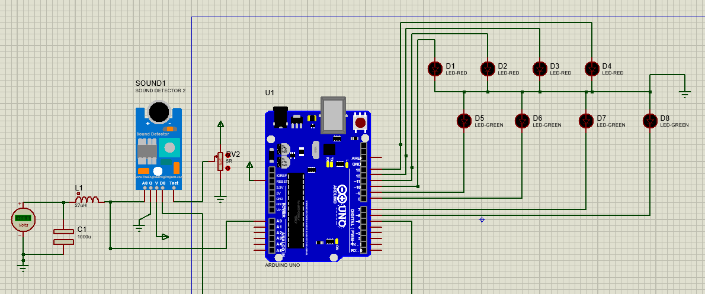
Circuit Diagram
5
Figure 2: Circuit diagram in proteus 8

Slide 8
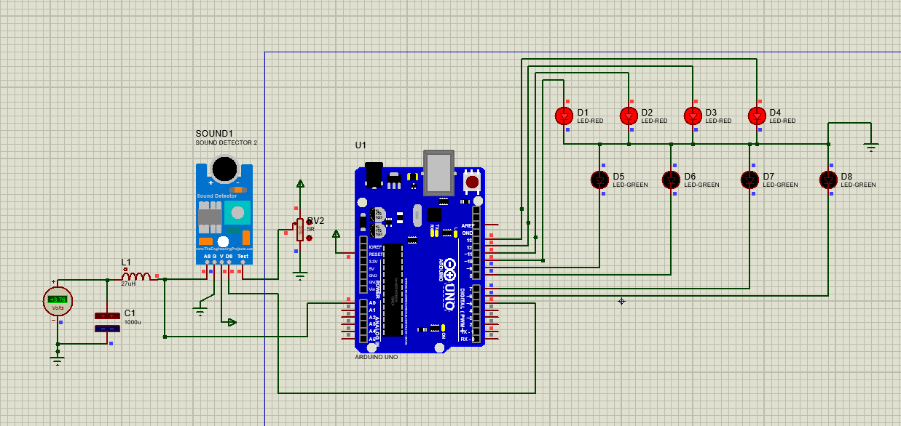
Simulation
6
Figure 3: Simulation in proteus 8

Slide 9
Working Progress
7
Simulation(Done): Simulated the project in proteus 8 to see if it was feasible.
Arduino Code (Done): Programmed the Arduino to get desired output.
Hardware Setup (Partial):
Integrating the microphone and adjusting the
frequency to succesfully detect clap sound.
Testing (Partial): Fine-tuning the system for optimal performance and troubleshooting any issues.
Documentation(Partial): Started documenting the project progress, including design specifications, imulation results, Arduino code, hardware setup instructions, and testing procedures.

Slide 10
Working Progress
8
100%
Simulation
Done
Arduino code
100%
Done
Hardware setup
50%
Partial
Integration
50%
Partial
Testing
50%
Partial
Documentation
50%
Partial

Slide 11
Gantt Chart
9
Task | Start Date | End Date | Duration | Progress
Simulation | 2/10/2024 | 2/10/2024 | 1 | Done
Arduino code | 2/10/2024 | 2/10/2024 | 1 | Done
Hardware setup | 3/24/2024 | 4/5/2024 | 12 | Partial
Integration | 3/24/2024 | 4/5/2024 | 12 | Partial
Testing | 4/5/2024 | 4/15/2024 | 10 | Partial
Documentation | 2/10/2024 | 4/15/2024 | 65 | Partial

Slide 12
Conclusion
1
0
Overall, significant progress has been made in the development of
the Clap switch. Despite encountering some challenges, the project is on
track for successful completion within the specified timeline. Further
testing and refinement are necessary to ensure the effectiveness and
robustness of the system.

Slide 13
Thanks!

